Slide 1
Review: Modelling with independent components Christian F. Beckmann (2012)
Presentation by Christian McDaniel
PHYS 6510 – 26 Nov. 2018

Slide 2
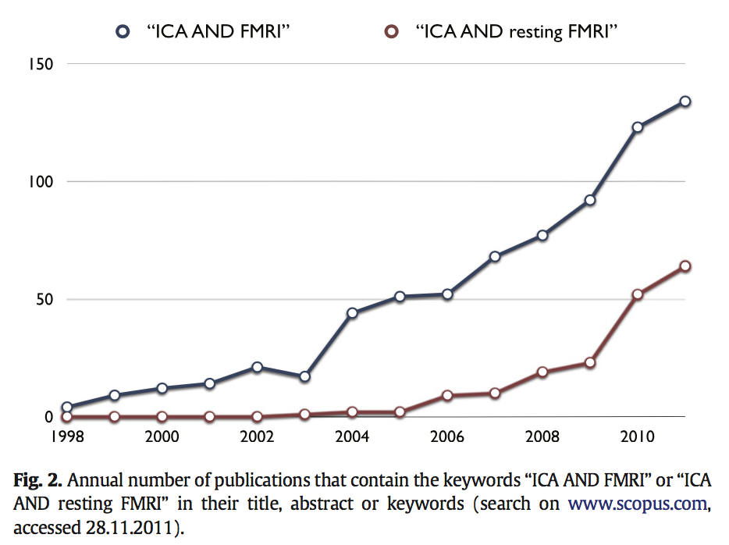
Abstract
Independent Component Analysis (ICA) is a computational technique for identifying hidden statistically independent sources from multivariate data
Statistics, data exploration, signal processing, neural networks
This review paper marks (about) 20 Years of research using ICA for finding hidden source signals in fMRI data
The algorithm has seen increasing use in the cognitive and clinical neuroscience settings
After a short introduction to ICA, the probabilistic extension to ICA will be discussed, followed by a few “loose ends,” notable “killer applications,” and ”future” directions

Slide 3
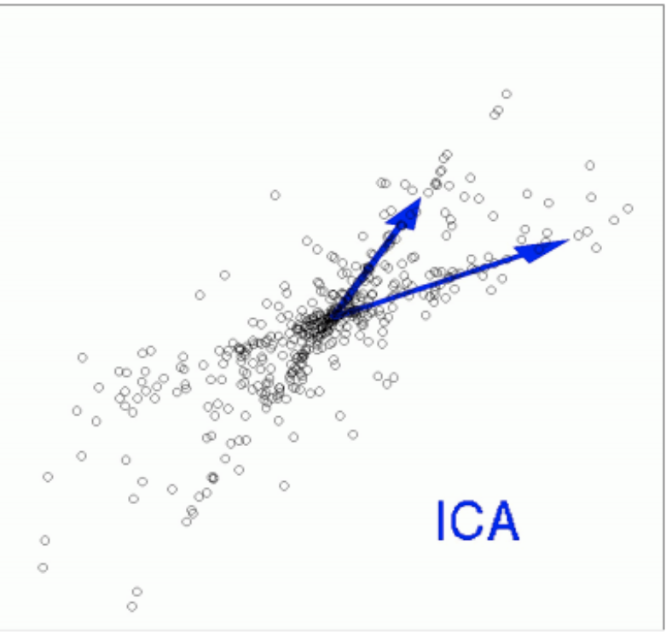
Background Key Concepts
Independent Component Analysis (ICA):
Represent 2D data as linear combinations of independent source components
Information theoretic principles drive the estimation of the joint distributions
Seeks to solve the Blind Source Problem (BSS)
Y(t) = A S(t)
S(t) are the source signals, A is the mixing matrix
Find linear transformation L (ideally A⁻¹) s.t. L Y(t) = S(t)
Popular algorithms include Infomax and FastICA
Notes:
Blind source separation (BSS) problem: undoing the mixing process re: mixture of underlying source signals where original signals and mixing transformation are unknown
Estimates high-order statistics (e.g., skew – offset, and kurtosis – tailedness) re the distributions
Think of matrices as transformations
A and S are unknown
S and A are identifiable i.f.f. there exists at most one Gaussian signal among the sources (i.e., noise)
ICA is similar to GLM Y=XB except Y and X are known instead of just Y
2 popular approaches: Infomax algorithm, FastICA
Both use non-linear transforms to drive the estimation
Infomax: maximum information transfer (i.e., minimization of mutual information between estimated sources)
FastICA: achieving maximum degree of non-Gaussianity for all estimated source signals

Slide 4
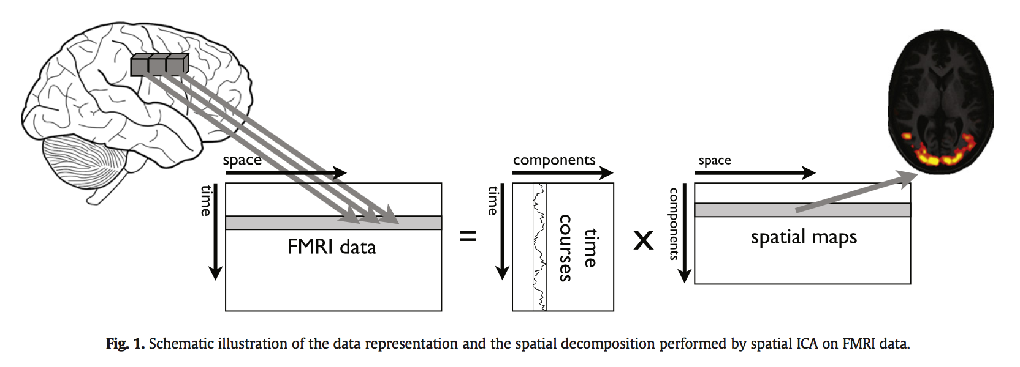
Background Key Concepts
Spatial ICA for fMRI:
fMRI data has low SNR resulting in a mixture of signals
Follows from the localized paradigm of classical neuroscience
Assumes areas of interest are independently distributed
Research aided by software tools: Brainvoyager, FSL, DTU, GIFT
Notes:
BOLD-response to stimulation obscured by various other sources of variability (e.g., machine artefacts, physiological pulsation, head motion, haemodynamic changes)
Source directions or signal signatures &
Maps may be of stimulus induced activity, task-unrelated (ongoing) activity, signal artefacts

Slide 5
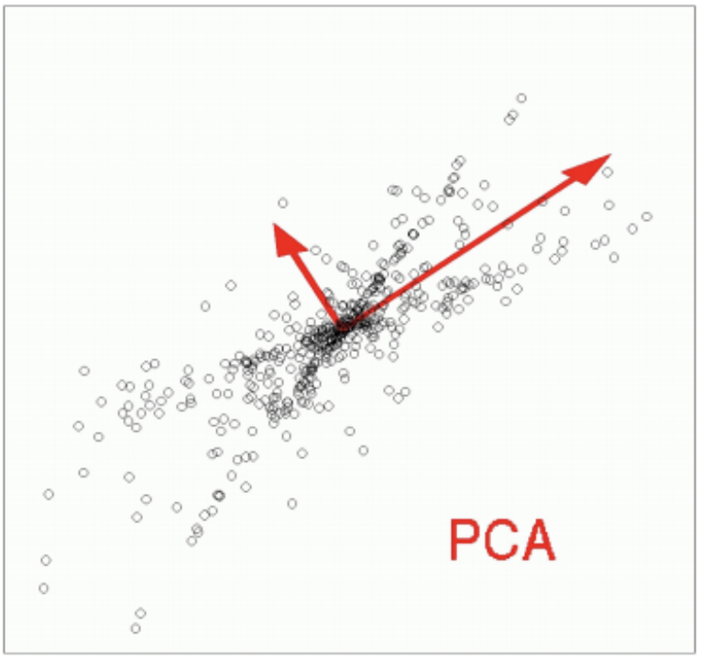
Background Supplementary Concepts
PCA
Finds direction of highest variance (basis vectors)
PCs are the eigenvectors of the covariance matrix
Used as preprocessing for ICA (more on this later)
Gaussian/Gamma Mixture Model (GGMM)
Gaussian distribution models the noise
Gamma distribution (shape and scale params) models the activity class
Null Hypothesis,H₀ / Alternative Hypothesis, H₁
FMRIB Centre in Oxford:
FMRIB Software Library (FSL)
Multivariate Exploratory Linear Optimized Decomposition into Independent Components (MELODIC)
Notes:
Principle Components = Eigenvectors of covariance matrix (orthogonal)

Slide 6
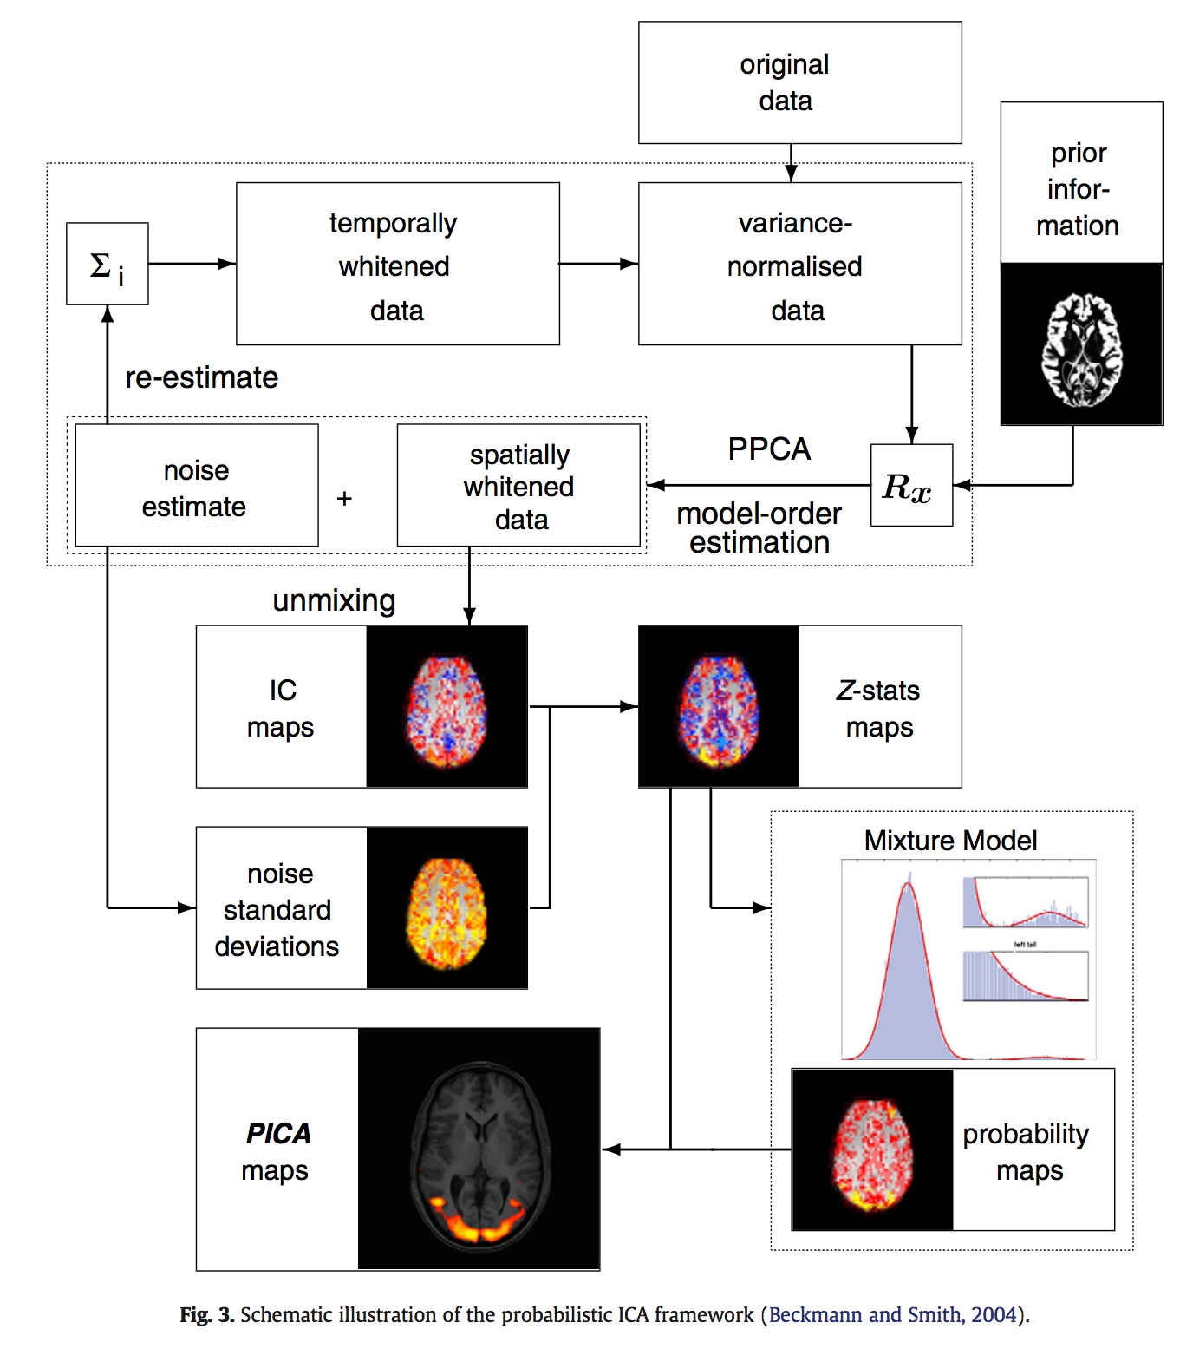
Probabilistic ICA - MELODIC
Notes:
Adds a noise term to traditional ICA
variance normalization (VN) - original data demeaned and normalized → unit noise variance
So that ICA doesn’t gravitate toward uninsteresting (Gaussian) strong signals (e.g., voxels in CSF – very bright and lots of associated variance)
requires knowledge of the signal in order to define what the noise is that needs to be forced to have the same noise variance across space
iteratively perform normalization and PPCA to split data space into initial noise and signal sub-spaces where former is used to refine normalization steps
MELODIC: unmixing performed via FASTICA
Final step: statistical inference – estimated IC maps transformed to voxel-wise Z-statistics (Standardized)
Divide the raw IC maps from ICA by the standard dev. Of the residuals from the initial PPCA
Rx = covariance matrix
Propr information – spatial smoothing or prior info about the importance of particular voxels (seeding)
Whitening – transform the data to have covariance matrix = identity matrix (all components are independent)

Slide 7
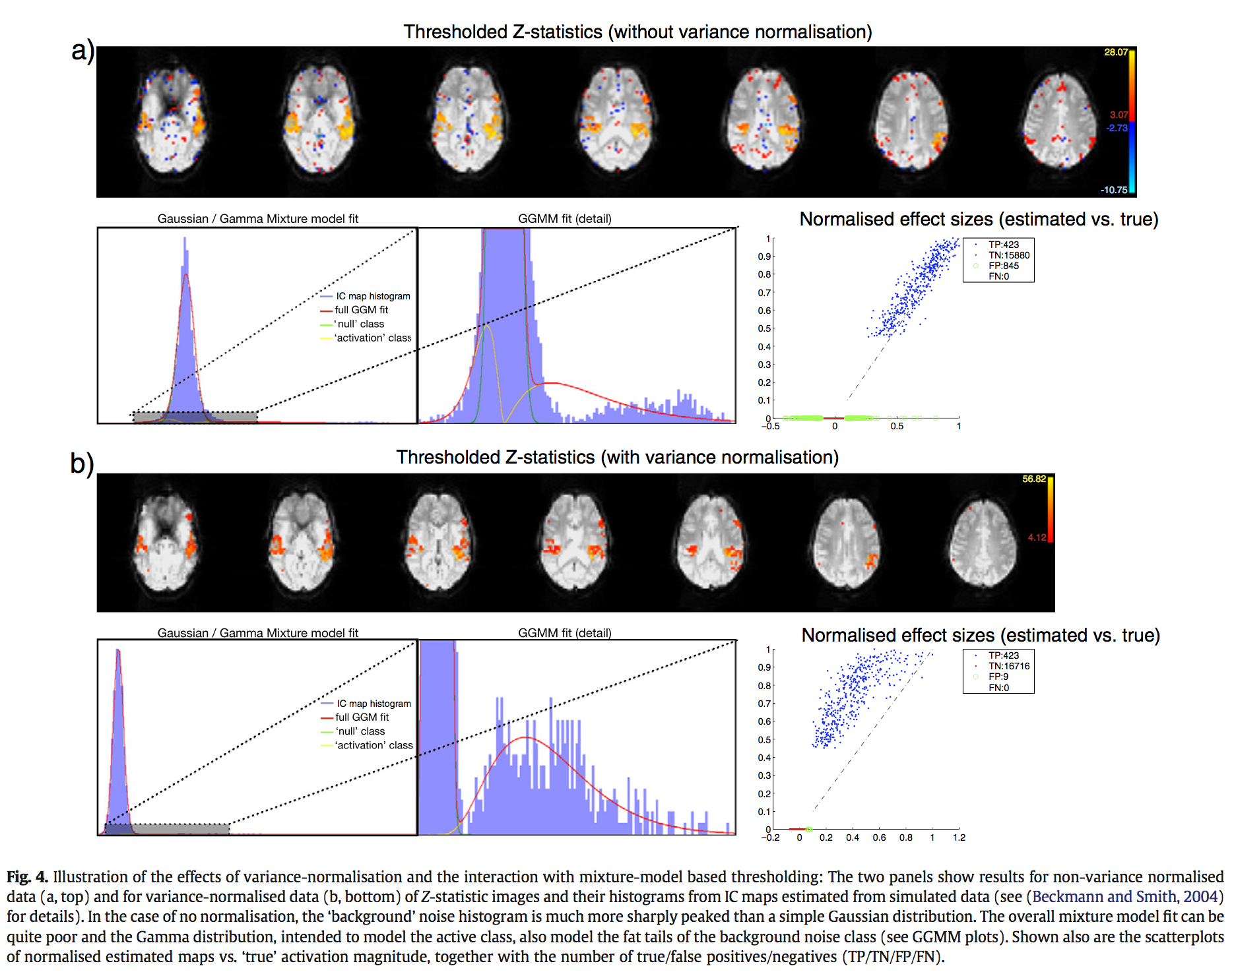
VN, Thresholding, and Quality of Fit
Notes:
infer voxels significantly modulated by the component time courses
Mixture model fitted to the component’s histogram
This permits alternative hypoth. testing in addition to null hypoth. testing b/c background noise and signal distributions are modelled (can test probability for both classes)
((Not necessary to discuss:
Extra innovation of spatial mixture model with adaptive regularization to be used on fMRI activation/statistic maps → neighborhood information explicitly incorporated into the estimation of class membership
MELODIC uses non-spatial version, b/c ICA viewed to be strong spatial filter already and due to variation in spatial characteristics across ICA artefact maps (spatial regularization would smooth across some of these artefacts making them resemble BOLD signals) ))
VN → IC computed on initial z-stat --> classification instead of regression

Slide 8
ICA Loose Ends
Using default output (p > 0.5) and H₁-testing
1
Thresholding: Controlling for FP (Cog. Sci.) vs. Controlling for FN (Clinical)
2
Correctness of thresholding depends on appropriateness of distributions
3
Model order selection
4
Notes:
Gamma distribution for activation class chosen for mathematical convenience
Can use non-parametric distributions (e.g., splines)
Or pseudo-null hypothesis testing
Early research – extract as many as required to model certain proportion of variablility in data
Informatic theoretic estimates of the intrinsic dimensionality of the data
MELODIC – information theoretic analysis of the Eigen spectrum of the data covariance matrix
Is there truly an optimal number of components? What does this optimum look like?
Concern re: using linear approach for potentially non-linear signals (e.g., head motion, although many studies have resulted in reliable spatial maps across model order (e.g., 20 – 70 representing same but finer-grained maps)
Different model order can result in substantially different results (just as GLM can yield different results due to diff. modelling decisions)

Slide 9
”Killer Applications”
Adoption of ICA was somewhat slow due to satisfaction with classical methods (GLM)
ICA has been shown to have strong advantages in a few “killer applications”

Slide 10
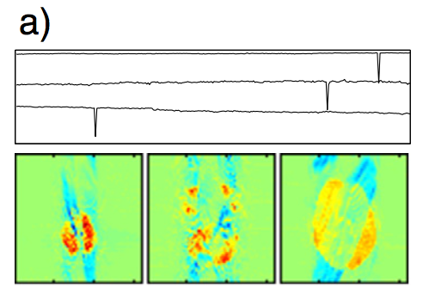
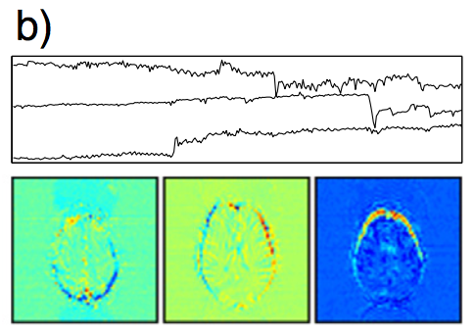
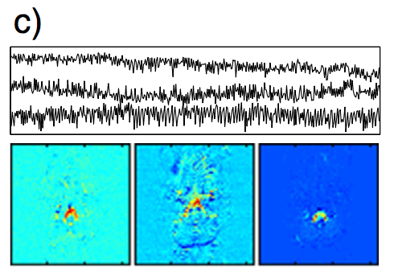
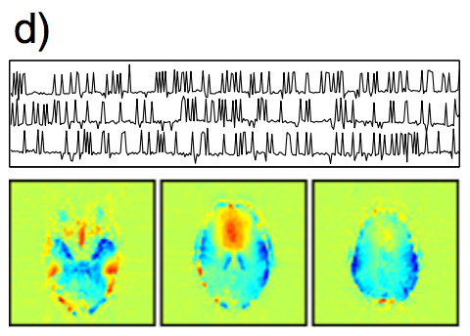
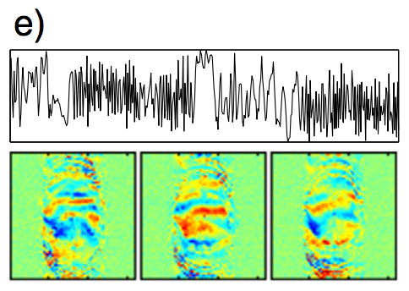
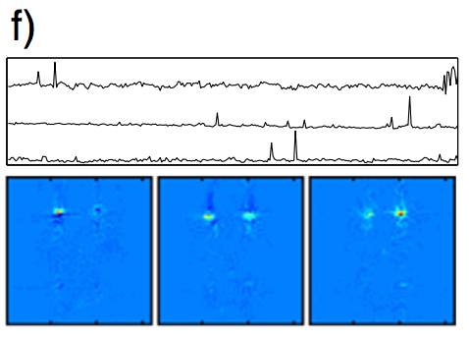
“Killer Applications” Artifact Detection & Removal
slice dropouts
b) head motion
c) high-frequency noise
d) hardware spiking
e) N/2-ghost image
f) eye-blink artefact
Notes:
Preprocessing removes the worst of the artefacts (motion and distortion correction, temporal and spatial filtering prior to analysis or outlier modeling)
Residual noise shown to have spatial and temporal structures
A) (scanner hardware prob) gradient waveform corruptions – diagonal object ghosting)
B) (even with head immobilized, respiration or cardiac cycle can cause motion of brain) → rim-like effect near strong intensity edges of the image
C) largely within CSF
D) (scanner hardware prob) (instability of relative timing of the slice select gradient and RF. pulse waveform, e.g., due to faulty device on the driving console)
E) N/2-ghost image, interacting with head motion (specific to EPI, inconsistencies in timing b/t image acquisition and gradient switching → differences in even and odd acquisition lines in k-space) sometimes called Nyquist ghost (but not related to Nyquist sampling freq)
F) eye-blink artefact (can remove signals from eye volumes, but eye-blink can combine with N/2 ghost s.t. the modulation wraps around the FOV into posterior cortical areas

Slide 11
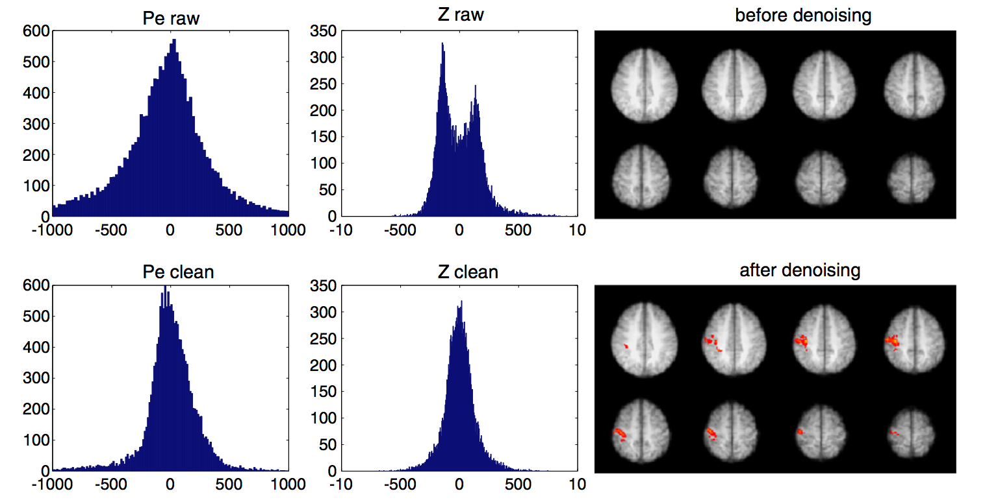
“Killer Applications” Denoising for improved GLM-based analysis
Assumption: residual errors are Gaussian distributed
Artefacts can affect GLM Regression coefficients (if partially correlated with the design)
Use the information from ICA to remove certain voxels or time points from analysis
Notes:
Any non-gaussian process not modelled by the design or removed by preprocessing violates the assumption that residual errors should be gaussian distributed
Pe = parameter estimates
(e.g., slice dropout – interpolate time point as mean of preceding and following time points)
Compare ICA before and after motion correction to measure efficacy (spatial maps and tc’s)
Intelligent filter: combine spatial maps with associated time courses to form estimate of the non-Gauss. Structured noise in data and subtracting this noise
makes no alternative hyp assumptions and can be combined ith later null hyp. Testing
(e.g., feeding denoised fmri data into classical glm analysis)

Slide 12
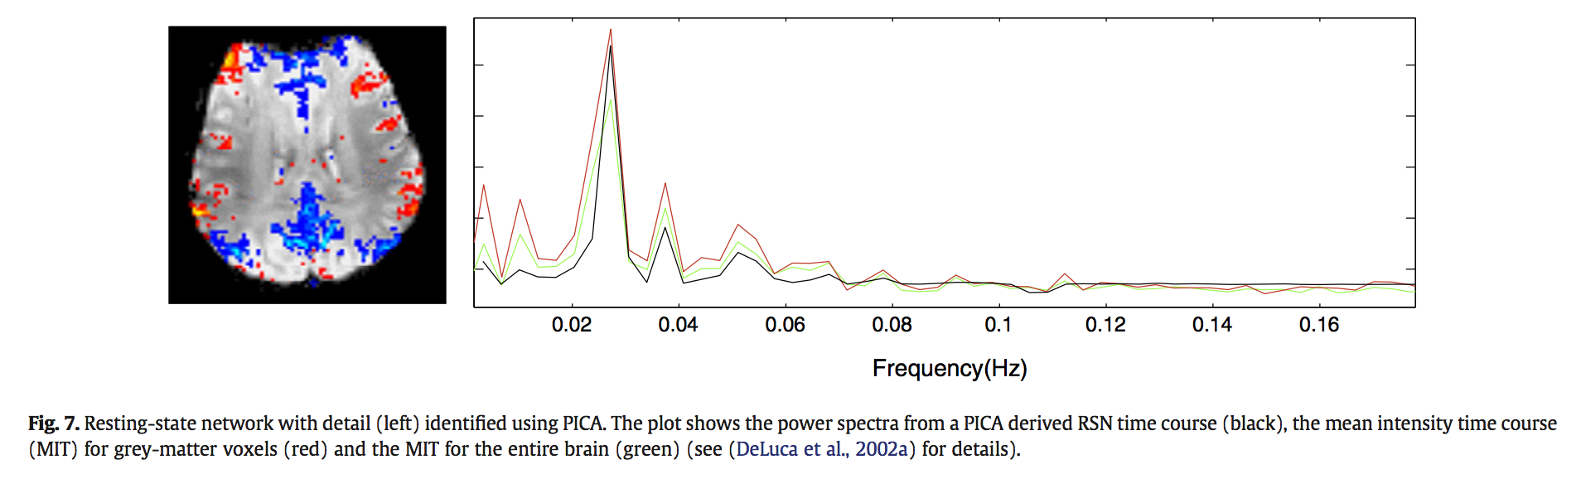
”Killer Applications” resting-state fMRI (rs-fMRI)
Resting-State Networks (RSNs) experimental validation:
test-retest experiments,
shown to be sensitive biomarkers for neurodegenerative diseases, psychiatric illnesses, and heritability
Heavily intertwined with the global mean signal (GMS)
Does not lend itself easily to GLM-based analysis
ICA identifies multiple RSNs from a single session of resting data due to inherent multivariate nature
Notes:
Common method in PET scans is to subtract the GMS
Much of the physiological noise in fMRI’s is from RSNs
GMS has an associated non-global spatial structure representing RSNs

Slide 13
“Future” Directions
Between-subject variability and population statistics
Multi-modal Imaging and Auxiliary Data
Temporal dynamic ICA
Notes:
variation = inadequacy → biologically meaningful difference → disease/genetic morphology identification
single matrix for ICA
Difficult to weight the differing degrees of informativeness
Separate ICA’s not practical due to problematic post hoc data fusion across diff sets of components
Linked-ICA
Simultaneously modelling common features across multiple data modalities
High voxel:time point → spatial domain
→ largely non-overlapping component maps, and functional interactivity between different components is largely unexplored
Short-TR functional imaging → more time points → temporal ICA
Temporally independent modes of function → group by time instead of group by space
amongst spatially independent signals might shed more light on the fundamental building blocks of brain activity
(missing link between structure and function?)

Slide 14
Conclusion
The efficacy of ICA has been demonstrated in both cognitive and clinical neuroscience fields
Various estimation algorithms exists, and PICA has improved the classical methods by adding a stochastic noise term
After 20 years of research, the evolution of ICA remains unfinished regarding:
- practical understanding
- theoretical rigor
- avenues for extension and application
Given ICA’s profound contributions in various applications, and its increased use in research, exciting adaptations and applications are expected over the next 20 years

